Slide 1

Visual Studio Code
Matt Strong
February 22nd, 2019

Slide 2
TABLE OF CONTENTS
VS CODE
Overview
Installation
Basic Navigation
Playing Around
Fun Fact!
Closing Thoughts

Slide 3
Here. We. Go.

Slide 4
Me
CS Undergrad at CU Boulder
Ex-Microsoft Tech-Lead for HackCU
Interests
Robotics
Computer Vision
Misc
Basketball
Running, swimming, biking

Slide 5
OVERVIEW
VS Code is a text editor
NOT an IDE
Visual Studio
Simple navigation
Numerous extensions
Great for beginners
Isn’t a more pure text editor like VIM or EMACS
But doesn’t do a lot of heavy lifting for you (VS)

Slide 6
WHY SHOULD I CONSIDER VS CODE?
Lightweight to use
Well supported, constantly being updated
Extensions really speed up development

Slide 7
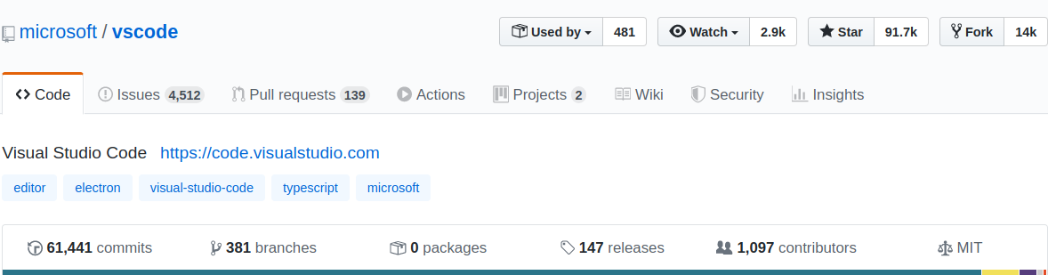
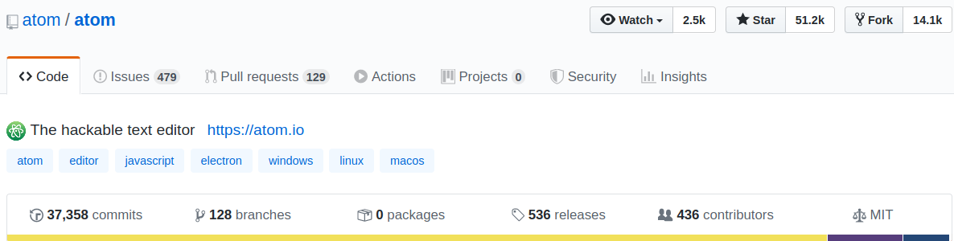
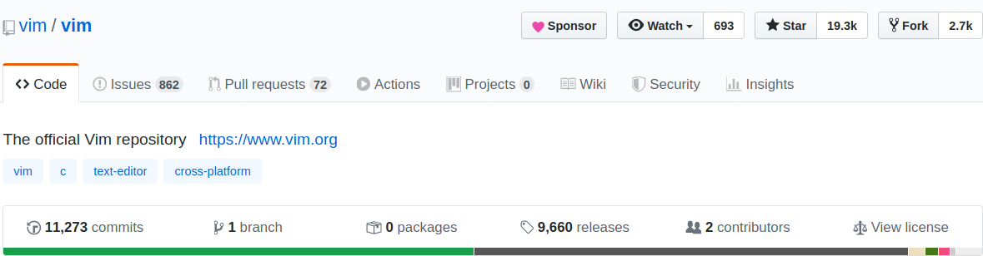

Slide 8
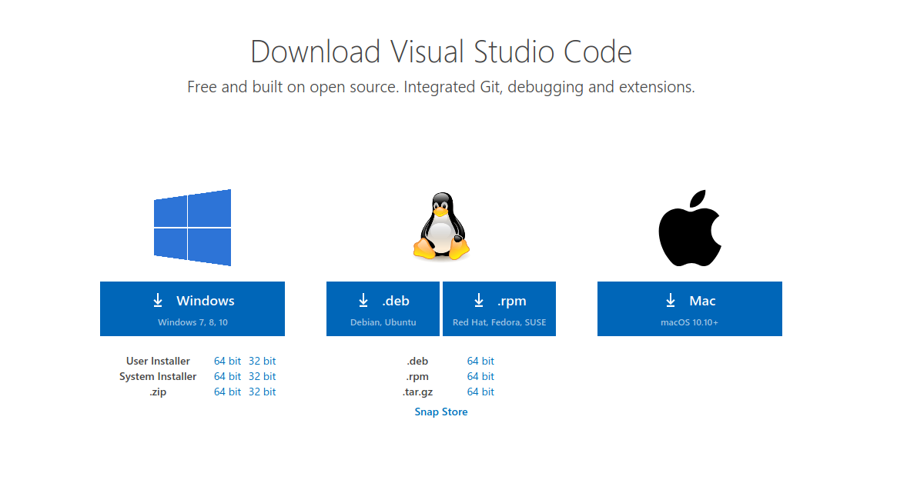
INSTALLATION
Install here: https://code.visualstudio.com/download
Choose your OS

Slide 9
DOWNLOAD
If you don’t yet have Git installed, do so here: https://git-scm.com/downloads
Python installation! https://www.python.org/downloads/
Python3

Slide 10
Get code!
Run
git clone https://github.com/hackcu/workshops
Raise your hand if you need help!

Slide 11
Exploring the Editor
Let’s explore some of the features of VS Code!

Slide 12
Opening the folders
Open VS Code!
First Shortcut:
Mac - ⇧⌘N
Windows - Ctrl Shift N
Linux - Ctrl Shift N
Opens new window

Slide 13
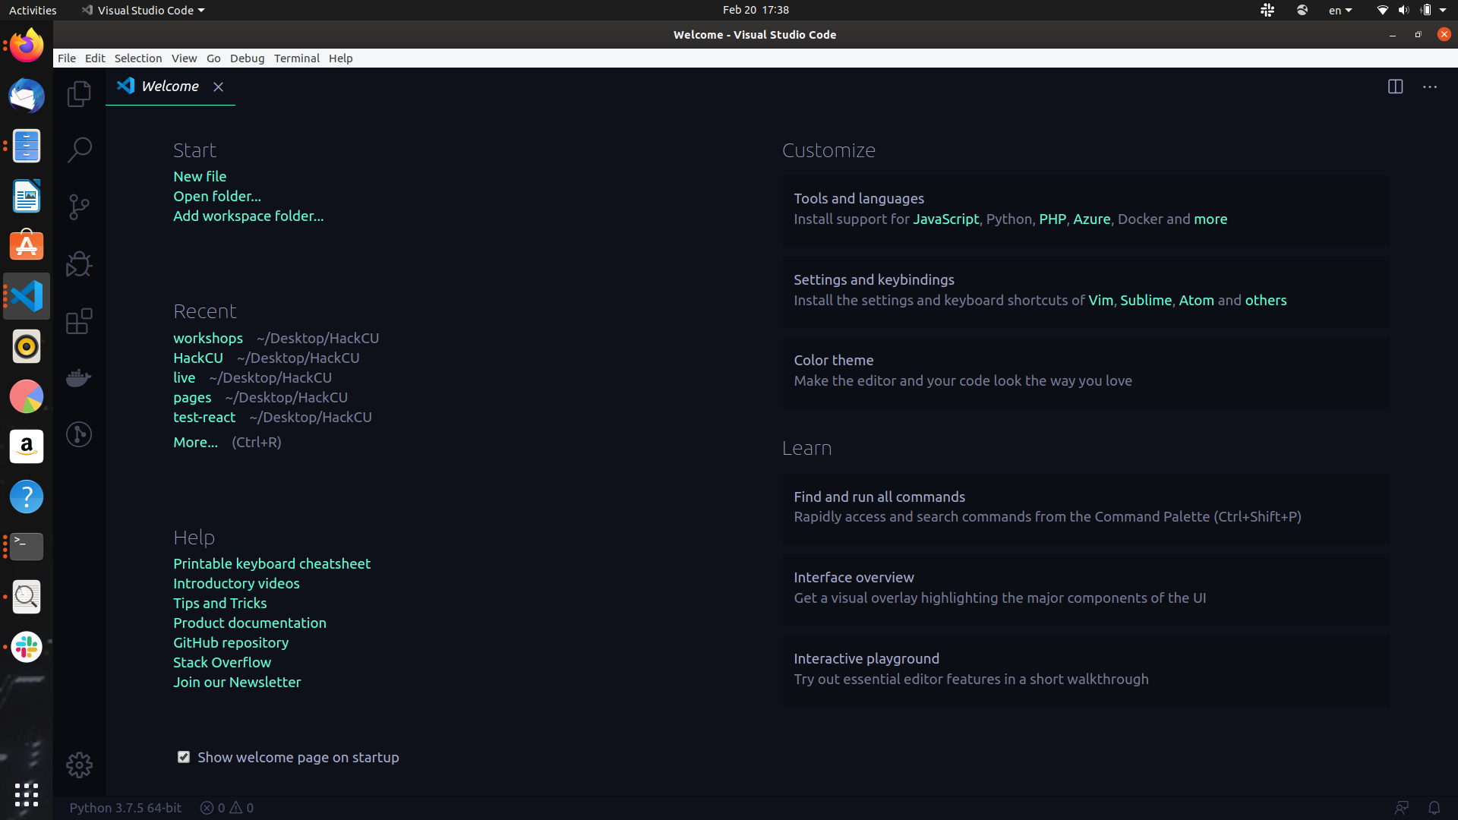

Slide 14
Exploring Around
Explorer
Mac - ⇧⌘E
Windows - Ctrl Shift E
Linux - Ctrl Shift E
Notes:
Introduce the audience to the basic layout of VS Code.

Slide 15
Exploring Around
Search
Mac - ⇧⌘F
Windows - Ctrl Shift F
Linux - Ctrl Shift F
Notes:
Introduce the audience to the basic layout of VS Code.

Slide 16
Exploring Around
Source Control
Mac - ⇧⌘G
Windows - Ctrl Shift G
Linux - Ctrl Shift G + G
You can see changes!
Notes:
Introduce the audience to the basic layout of VS Code.

Slide 17
Exploring Around
Debugging
Mac - ⇧⌘D
Windows - Ctrl Shift D
Linux - Ctrl Shift D
Notes:
Introduce the audience to the basic layout of VS Code.

Slide 18
Exploring Around
Extensions
Mac - ⇧⌘E
Windows - Ctrl Shift E
Linux - Ctrl Shift E
One of the big pros of VS Code!!
Notes:
Get some extensions

Slide 19
Get Extensions:
Python
Beautify
Makes code look a little better
Notes:
Get some extensions

Slide 20
Some code
Open hacker_fun.py
Notes:
Get some extensions

Slide 21
Brief Shortcuts
Open hacker_fun.py
Notes:
Get some extensions

Slide 22
I wrote broken code, let’s debug it!
Open debugging.py
Notes:
Get some extensions

Slide 23
Unscramble
Unscramble scrambled.py with VS Code shortcuts.
Raise thy hand if you have any questions!
Notes:
Get some extensions

Slide 24
Best Extension for VS Code
“Edit csv”
Open-source contribution to extensions!
Notes:
Get some extensions

Slide 25
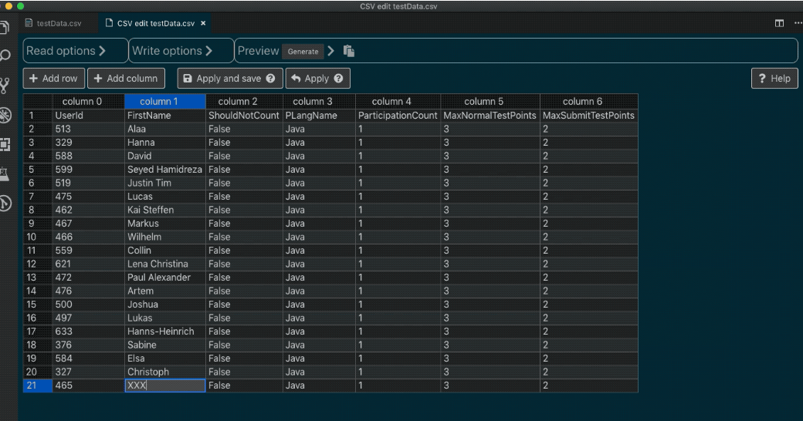

Slide 26

Usage of the GOAT extension

Slide 27
Extension: Beautify
Let’s beautify some html!

Slide 28
Final Showdown
Exercise:
Go to line 2020 of test10.txt, copy that number
Go to get_fun_fact.py, line 26, replace the string in get_fun_fact function
Run the code!

Slide 29
Cool Fact?

Slide 30
Closing Thoughts
Saves time, you can focus on developing

Slide 31

THANKS!
This is a cool slide
Any questions?
You can find me at
mast4878@colorado.edu
Follow me on Github @peasant98

